Slide 1

Obstetrics and Neonatal Care
CHAPTER 34

Slide 2
National EMS Education Standard Competencies (1 of 7)
Special Patient Populations
Applies a fundamental knowledge of growth, development, and aging and assessment findings to provide basic emergency care and transportation for a patient with special needs.
Notes:
National EMS Education Standard Competencies
Special Patient Populations
Applies a fundamental knowledge of growth, development, and aging and assessment findings to provide basic emergency care and transportation for a patient with special needs.

Slide 3
National EMS Education Standard Competencies (2 of 7)
Obstetrics
Recognition and management of
  Normal delivery
  Vaginal bleeding in the pregnant patient
Anatomy and physiology of normal pregnancy
Pathophysiology of complications of pregnancy
Notes:
National EMS Education Standard Competencies
Obstetrics
• Recognition and management of
Normal delivery
Vaginal bleeding in the pregnant patient
• Anatomy and physiology of normal pregnancy
• Pathophysiology of complications of pregnancy

Slide 4
National EMS Education Standard Competencies (3 of 7)
Obstetrics (cont’d)
Assessment of the pregnant patient
Management of
  Normal delivery
  Abnormal delivery
    Nuchal cord
    Prolapsed cord
    Breech delivery
Notes:
National EMS Education Standard Competencies
• Assessment of the pregnant patient
Management of
• Normal delivery
• Abnormal delivery
Nuchal cord
Prolapsed cord
Breech delivery

Slide 5
National EMS Education Standard Competencies (4 of 7)
Management of (cont’d)
  Third trimester bleeding
    Placenta previa
    Abruptio placenta
  Spontaneous abortion/miscarriage
  Ectopic pregnancy
  Preeclampsia/eclampsia
Notes:
National EMS Education Standard Competencies
Management of
• Third trimester bleeding
Placenta previa
Abruptio placenta
• Spontaneous abortion/miscarriage
• Ectopic pregnancy
• Preeclampsia/eclampsia

Slide 6
National EMS Education Standard Competencies (5 of 7)
Neonatal Care
Assessment and management of
  Newborn care
  Neonatal resuscitation
Notes:
National EMS Education Standard Competencies
Neonatal Care
Assessment and management of
• Newborn care
• Neonatal resuscitation

Slide 7
National EMS Education Standard Competencies (6 of 7)
Trauma
Applies fundamental knowledge to provide basic emergency care and transportation based on assessment findings for an acutely injured patient.
Notes:
National EMS Education Standard Competencies
Trauma
Applies fundamental knowledge to provide basic emergency care and transportation based on assessment findings for an acutely injured patient.

Slide 8
National EMS Education Standard Competencies (7 of 7)
Special Considerations in Trauma
Recognition and management of trauma in the
  Pregnant patient
Pathophysiology, assessment, and management of trauma in the
  Pregnant patient
Notes:
National EMS Education Standard Competencies
Special Considerations in Trauma
• Recognition and management of trauma in the
Pregnant patient
Pediatric patient
Geriatric patient
• Pathophysiology, assessment, and management of trauma in the
Pregnant patient
Pediatric patient
Geriatric patient
Cognitively impaired patient

Slide 9
Introduction
Most deliveries occur in a hospital.
Occasionally, the pregnant woman is unable to get to a hospital.
You must then decide whether to:
  Assist the delivery on scene.
  Transport the patient to the hospital.
Notes:
Lecture Outline
I. Introduction
A. Most childbirths in the United States occur in a health care setting with trained medical personnel in attendance.
B. Occasionally, the the pregnant woman is unable to get to a hospital.
You must then decide whether to:
1. Assist the delivery on scene.
2. Transport the patient to the hospital

Slide 10
Anatomy and Physiology of the Female
Reproductive System (1 of 9)
The ovaries are two glands, one on each side of the uterus.
  Similar in function to the male testes
  Each ovary contains thousands of follicles, and each follicle contains an egg.
  Ovulation occurs approximately 2 weeks prior to menstruation.
Notes:
Lecture Outline
A. The ovaries are two glands, one on each side of the uterus, that are similar in function to the male testes.
1. Each ovary contains thousands of follicles, and each follicle contains an egg.
2. Ovulation occurs approximately 2 weeks prior to menstruation.
3. If fertilized, the egg implants in the endometrium, the lining of the inside of the uterus.
4. If the egg is not fertilized within 36 to 48 hours after it has been released, it will die, and the lining is shed as menstrual flow. a. Occurs around the 28th day of a woman’s cycle

Slide 11
Anatomy and Physiology of the Female
Reproductive System (2 of 9)
The fallopian tubes extend out laterally from the uterus, with one tube associated with each ovary.
  Fertilization usually occurs when the egg is inside the fallopian tube.
  The fertilized egg continues to the uterus where implantation occurs.
Notes:
Lecture Outline
B. The fallopian tubes extend out laterally from the uterus, with one tube associated with each ovary.
1. Fertilization usually occurs when the egg is inside the fallopian tube.
2. The fertilized egg then continues to the uterus where, if implantation occurs, it develops into an embryo and then a fetus and grows until the time of delivery.

Slide 12
Anatomy and Physiology of the Female
Reproductive System (3 of 9)
The uterus is a muscular organ that encloses and protects the fetus as it grows.
  Produces contractions during labor
  Helps to push the fetus through the birth canal
  The birth canal is made up of the vagina and the lower third of the uterus, called the cervix.
Notes:
Lecture Outline
C. The uterus is a muscular organ that encloses and protects the fetus.
1. The uterus produces contractions during labor and ultimately helps to push the fetus through the birth canal.
2. The birth canal is made up of the vagina and the lower third of the uterus, called the cervix.

Slide 13
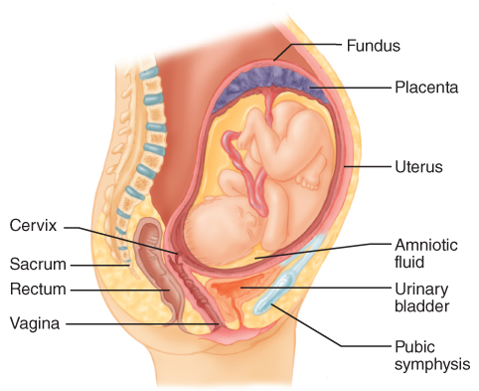
Anatomy and Physiology of the Female
Reproductive System (4 of 9)
FIGURE 34-1 Anatomic structures of the pregnant woman.
© Jones & Bartlett Learning.
Notes:
The figure on this slide shows the anatomic structures of a pregnant woman.

Slide 14
Anatomy and Physiology of the Female
Reproductive System (5 of 9)
The vagina is the outermost cavity of the female reproductive system and forms the lower part of the birth canal.
  Completes the passageway from the uterus to the outside world
  The perineum is the area of skin between the vagina and the anus.
Notes:
Lecture Outline
D. The vagina is the outermost cavity of the female reproductive system and forms the lower part of the birth canal.
1. Completes the passageway from the uterus to the outside world for the newborn.
2. The perineum is the area between the vagina and the anus.

Slide 15
Anatomy and Physiology of the Female
Reproductive System (6 of 9)
The breasts produce milk that is carried through small ducts to the nipple to provide nourishment to the newborn once it is born.
  Early signs of pregnancy in the breasts include increased size and tenderness.
Notes:
Lecture Outline
E. In a pregnant woman, the breasts produce milk that is carried through small ducts to the nipple to provide nourishment to the newborn once it is born.

Slide 16
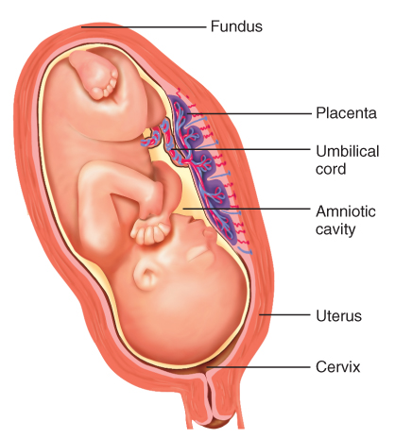
Anatomy and Physiology of the Female
Reproductive System (7 of 9)
The placenta attaches to the uterine wall and connects to the fetus by the umbilical cord.
FIGURE 34-2 The placental barrier keeps the maternal and fetal blood separate but allows nutrients, oxygen, waste, carbon dioxide, toxins, and most medications to pass between the fetus and pregnant woman.
© Jones & Bartlett Learning.
Notes:
Lecture Outline
F. The placenta is a disk-shaped structure attached to the uterine wall that provides nourishment to the fetus.
1. Keeps the circulation of the woman and fetus separated but allows substances to pass between them
2. Anything ingested by a pregnant woman has the potential to affect the fetus.
3. The umbilical cord connects the woman and fetus through the placenta.
a. The umbilical vein carries oxygenated blood from the placenta to the heart of the fetus.
b. The umbilical arteries carry deoxygenated blood from the heart of the fetus to the placenta.

Slide 17
Anatomy and Physiology of the Female
Reproductive System (8 of 9)
After delivery, the placenta separates from the uterus and delivers.
The umbilical cord is the lifeline of the fetus.
  The umbilical vein carries oxygenated blood from the placenta to the fetus.
  The umbilical arteries carry deoxygenated blood from the fetus to the placenta.
Notes:
Lecture Outline
3. The umbilical cord is the lifeline of the fetus, connecting the woman and fetus through the placenta.
a. The umbilical vein carries oxygenated blood from the placenta to the heart of the fetus.
b. The umbilical arteries carry deoxygenated blood from the heart of the fetus to the placenta.

Slide 18
Anatomy and Physiology of the Female
Reproductive System (9 of 9)
The fetus develops inside a fluid-filled, baglike membrane called the amniotic sac.
  Contains about 500 to 1,000 mL of amniotic fluid
  Helps insulate and protect the fetus
  Fluid is released in a gush when the sac ruptures, usually at the beginning of labor.
Notes:
Lecture Outline
G. The fetus develops inside a fluid-filled, baglike membrane called the amniotic sac.
1. The sac contains about 500 to 1,000 mL of amniotic fluid, which helps insulate and protect the floating fetus.
2. The amniotic fluid is released in a gush when the sac ruptures, usually at the beginning of labor.

Slide 19
Normal Changes in Pregnancy (1 of 6)
Many normal changes occur in the body that are not all directly related to the reproductive system.
  Respiratory
  Cardiovascular
  Musculoskeletal
Notes:
Lecture Outline
III. Normal Changes in Pregnancy
A. During pregnancy, four body systems undergo major physiologic and anatomic changes.
1. These are the respiratory, cardiovascular, and musculoskeletal systems.

Slide 20
Normal Changes in Pregnancy (2 of 6)
Hormone levels increase.
  To support fetal development and prepare the body for childbirth
  Uterus is displaced from its protected position within the pelvis.
    This increases the chance of direct fetal injury in trauma.
Notes:
Lecture Outline
B. In the reproductive system, hormone levels increase to support fetal development and prepare the body for childbirth.
1. This puts pregnant woman at an increased risk for complications from trauma, bleeding, and some medical conditions.
2. Uterus is displaced out of its normally well-protected position within the pelvic area.
a. This increases the chance of direct fetal injury in trauma.

Slide 21
Normal Changes in Pregnancy (3 of 6)
Rapid uterine growth occurs during the second trimester.
  As the uterus grows, it pushes up on the diaphragm and displaces it.
  Respiratory capacity changes, with increased respiratory rates and decreased minute volumes.
Notes:
Lecture Outline
C. Rapid uterine growth occurs during the second trimester of pregnancy.
1. As the uterus grows, it pushes up on the diaphragm, displacing it from its normal position.
2. Respiratory capacity changes, with increased respiratory rates and decreased minute volumes.

Slide 22
Normal Changes in Pregnancy (4 of 6)
Blood volume gradually increases to:
  Allow for adequate perfusion of the uterus
  Prepare for the blood loss during childbirth
Number of red blood cells increases.
Speed of clotting increases.
Patient’s heart rate increases up to 20%.
Notes:
Lecture Outline
Overall blood volume gradually increases throughout the pregnancy to:
a. Allow for adequate perfusion of the uterus
b. Prepare for the blood loss that will occur during childbirth
4. Blood volume may eventually increase as much as 50% by the end of the pregnancy.
5. The number of red blood cells also increases.
6. The speed of clotting increases to protect against excessive bleeding during delivery.
7. By the end of pregnancy, the pregnant patient’s heart rate increases up to 20% to accommodate the increase in blood volume.
8. Cardiac output is significantly increased.

Slide 23
Normal Changes in Pregnancy (5 of 6)
Changes in the GI tract cause an increased risk for:
  Gastroesophageal reflux
  Nausea
  Vomiting
  Potential aspiration
Notes:
Lecture Outline
D. Pregnant women are at an increased risk for gastroesophageal reflux, nausea, vomiting, and potential aspiration because of changes that occur in the gastrointestinal tract.

Slide 24
Normal Changes in Pregnancy (6 of 6)
Weight gain during pregnancy is normal.
  Weight gain will challenge the heart and impact the musculoskeletal system.
  The joints become “looser” or less stable.
  Changes in the body’s center of gravity increase the risk of slips and falls.
Notes:
Lecture Outline
E. Weight gain during pregnancy is normal.
1. The increase in body weight will eventually challenge the heart and impact the musculoskeletal system.
2. Certain hormones affect the musculoskeletal system by making the joints “looser” or less stable.
3. In the third trimester, changes in the body’s center of gravity increase the risk of slips and falls.

Slide 25
Complications of Pregnancy
Most pregnant women are healthy.
Some may be ill when they conceive or become ill during pregnancy.
  Use oxygen to treat any heart or lung disease in a pregnant patient.
Notes:
Lecture Outline
IV. Complications of Pregnancy
A. Most pregnant women are healthy, but some may be ill when they conceive or become ill during pregnancy.
1. You may safely use oxygen to treat any heart or lung disease in a pregnant patient without harm to the fetus.

Slide 26
Diabetes
Develops during pregnancy in many women who have not had it previously
Gestational diabetes usually resolves after delivery.
Treatment is the same as for any other patient with diabetes.
Notes:
Lecture Outline
B. Diabetes
1. Diabetes develops during the second half of pregnancy in many women who have not had diabetes previously.
2. Gestational diabetes, resolves in most women after delivery.
3. The treatment is the same as for any other patient with diabetes.

Slide 27
Hypertensive Disorders (1 of 4)
Gestational hypertension
  The presence of high blood pressure in the absence of other systemic effects
  Systolic pressure higher than 140 mm Hg and diastolic pressure higher than 90 mm Hg
  Considered severe with systolic pressure is higher than 160 mm Hg and/or diastolic pressure higher than 110 mm Hg
Notes:
Lecture Outline
C. Hypertensive disorders
1. Gestational hypertension is the presence of high blood pressure in the absence of other systemic effects.
a. Defined as a systolic blood pressure higher than 140 mm Hg and a diastolic blood pressure higher than 90 mm Hg.
b. Considered severe when the systolic blood pressure is higher than 160 mm Hg and/or the diastolic pressure is higher than 110 mm Hg.

Slide 28
Hypertensive Disorders (2 of 4)
Preeclampsia is pregnancy-induced hypertension.
  Can develop after the 20th week of gestation
  Signs and symptoms include severe hypertension, severe or persistent headache, visual abnormalities, swelling in the hands and feet, and anxiety.
Notes:
Lecture Outline
2. Preeclampsia, or pregnancy-induced hypertension, can develop after the 20th week of gestation.
a. Characterized by the following signs and symptoms:
i. Severe hypertension
ii. Severe or persistent headache
iii. Visual abnormalities such as seeing spots, blurred vision, or sensitivity to light
iv. Swelling in the hands and feet (edema)
v. Upper abdominal or epigastric pain.
vi. Dyspnea and/or retrosternal chest pain
vii. Anxiety
viii. Altered mental status

Slide 29
Hypertensive Disorders (3 of 4)
Eclampsia is characterized by seizures that occur as a result of hypertension.
  To treat seizures caused by eclampsia:
    Lie the patient on her left side.
    Maintain her airway.
    Administer supplemental oxygen if necessary.
    If vomiting occurs, suction the airway.
    Provide rapid transport and call for ALS.
Notes:
Lecture Outline
3. Eclampsia is characterized by seizures that occur as a result of hypertension.
a. To treat seizures:
i. Lay the patient on her left side.
ii. Maintain her airway.
iii. Administer supplemental oxygen if necessary.
iv. If vomiting occurs, suction the airway.
v. Provide rapid transport.
vi. Call for an ALS intercept, if available.

Slide 30
Hypertensive Disorders (4 of 4)
Transporting the patient on her left side can also prevent supine hypotensive syndrome.
  Caused by compression of the descending aorta and the inferior vena cava by the pregnant uterus when the patient lies supine
Notes:
Lecture Outline
4. Transporting the patient on her left side can also prevent supine hypotensive syndrome.
a. Caused by compression of the descending aorta and the inferior vena cava by the pregnant uterus when the patient lies supine.

Slide 31
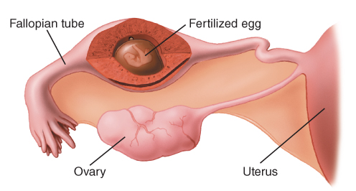
Bleeding (1 of 4)
Internal bleeding may be a sign of an ectopic pregnancy.
  An embryo develops outside the uterus, most often in a fallopian tube.
FIGURE 34-3 In an ectopic pregnancy, a fertilized egg implants somewhere other than in the uterus. Here, it is implanted in one of the fallopian tubes, the most common location for an ectopic pregnancy.
© Jones & Bartlett Learning.
Notes:
Lecture Outline
D. Bleeding
1. Internal bleeding may be a sign of an ectopic pregnancy, when an embryo develops outside the uterus, most often in a fallopian tube.
a. Sudden onset of severe abdominal pain and vaginal bleeding in the first trimester of pregnancy should be considered ectopic pregnancy until proven otherwise.
b. Consider the possibility of an ectopic pregnancy in a woman who has missed a menstrual cycle and complain of sudden, severe, usually unilateral pain in the lower abdomen.

Slide 32
Bleeding (2 of 4)
Consider an ectopic pregnancy in the presence of severe abdominal pain and vaginal bleeding during the first trimester.
Consider the possibility in a woman who has missed a menstrual cycle and complains of sudden, severe pain in the lower abdomen.
Notes:
Lecture Outline
a. Sudden onset of severe abdominal pain and vaginal bleeding in the first trimester of pregnancy should be considered ectopic pregnancy until proven otherwise.
b. Consider the possibility of an ectopic pregnancy in a woman who has missed a menstrual cycle and complains of sudden, severe, usually unilateral pain in the lower abdomen.

Slide 33
Bleeding (3 of 4)
Hemorrhage from the vagina that occurs before labor begins may be very serious.
May be a sign of spontaneous abortion, or miscarriage.
In abruptio placenta, the placenta separates prematurely from the wall of the uterus.
In placenta previa, the placenta develops over and covers the cervix.
Notes:
Lecture Outline
2. Hemorrhage from the vagina that occurs before labor begins may be very serious.
a. In early pregnancy, it may be a sign of a spontaneous abortion, or miscarriage.
b. In the later stages of pregnancy it may indicate
i. In abruptio placenta, the placenta separates prematurely from the wall of the uterus, most commonly caused by hypertension or trauma.
ii. In placenta previa, the placenta develops over and covers the cervix.
3. Any bleeding from the vagina in a pregnant woman is a serious sign and should be treated promptly in the hospital.
a. Treat for shock if signs are present.
b. Place a sterile pad or sanitary pad over the vagina and replace it as necessary.
c. Do not put anything into the vagina to control bleeding.

Slide 34
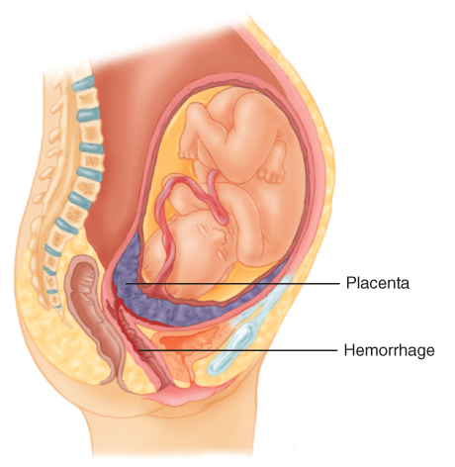
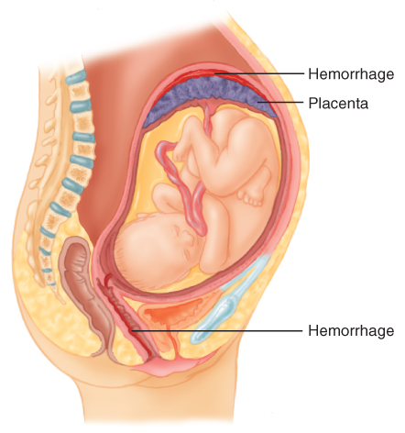
Bleeding (4 of 4)
FIGURE 34-4 In abruptio placentae, the placenta
separates prematurely from the wall of the uterus.
FIGURE 34-5 In placenta previa, the placenta develops over and covers the cervix.
© Jones & Bartlett Learning.
© Jones & Bartlett Learning.
Notes:
The figures on this slide show abruptio placenta and placenta previa.

Slide 35
Abortion
Passage of the fetus and placenta before 20 weeks
May be spontaneous or induced
Most serious complications are bleeding and infection.
If the woman is in shock, treat and transport her promptly to the hospital.
Notes:
Lecture Outline
E. Abortion
1. Spontaneous abortion is the loss of a pregnancy prior to 20 weeks of gestation without any preceding surgical or medical intervention.
a. The term is often used interchangeably with miscarriage.
2. An induced abortion is the elective termination of a pregnancy prior to the time of viability.
3. The most serious complications are bleeding and infection.
4. If the woman is in shock, treat and transport her promptly to the hospital.
5. Bring any tissue that passes through the vagina to the hospital.
a. Never pull tissue out of the vagina.

Slide 36
Abuse (1 of 2)
Pregnant women have an increased chance of being victims of domestic violence and abuse.
Abuse increases the chance of:
  Spontaneous abortion
  Premature delivery
  Low birth weight
Notes:
Lecture Outline
F. Abuse
1. Pregnant women have an increased chance of being victims of domestic violence and abuse.
2. Abuse during pregnancy increases the chance of spontaneous abortion, premature delivery, and low birth weight.

Slide 37
Abuse (2 of 2)
The woman is at risk from bleeding, infection, and uterine rupture.
Pay attention to the environment for any signs of abuse.
Talk to the patient in a private area, away from the potential abuser if possible.
Notes:
Lecture Outline
3. The woman is at risk from bleeding, infection, and uterine rupture.
4. Pay attention to the environment for any signs of abuse.
5. Pregnant patients who are abused are often scared and may not be honest as to how their injuries may have occurred.
a. Talk to the patient in a private area, away from the potential abuser if possible.

Slide 38
Substance Abuse (1 of 2)
Effects of addiction on the fetus include:
  Prematurity
  Low birth weight
  Severe respiratory distress
  Death
Fetal alcohol syndrome describes the condition of infants born to women who have abused alcohol.
Notes:
Lecture Outline
G. Substance abuse
1. The effects of the addiction on the fetus include:
a. Prematurity
b. Low birth weight
c. Severe respiratory distress
d. Death
2. Fetal alcohol syndrome describes the condition of infants born to women who have abused alcohol.

Slide 39
Substance Abuse (2 of 2)
Pay special attention to your safety.
Look for clues that you are dealing with an addicted patient.
The newborn will probably need immediate resuscitation.
Notes:
Lecture Outline
3. If you are called to handle a delivery of an addicted woman, pay special attention to your own safety.
4. Clues that you are dealing with an addicted patient may include:
a. The presence of drug paraphernalia
b. Empty wine or liquor bottles
c. Statements made by family or bystanders or by the patient herself
5. The newborn will probably need immediate resuscitation.

Slide 40
Special Considerations for Trauma and Pregnancy (1 of 8)
With a trauma call involving a pregnant woman, you have two patients:
  The woman
  The unborn fetus
Trauma to a pregnant woman may have a direct effect on the fetus.
Notes:
Lecture Outline
V. Special Considerations for Trauma and Pregnancy
A. With a trauma call involving a pregnant woman, you have two patients to consider—the woman and the unborn fetus.

Slide 41
Special Considerations for Trauma and Pregnancy (2 of 8)
Pregnant women also have an increased risk of falling.
  Loosened joints in the musculoskeletal system
  Increased weight of the uterus and displacement of abdominal organs can affect balance.
Notes:
Lecture Outline
B. Pregnant women also have an increased risk of falling compared with nonpregnant women.
1. Hormonal changes loosen the joints in the musculoskeletal system.
2. The increased weight of the uterus and displacement of abdominal organs can affect the woman’s balance.

Slide 42
Special Considerations for Trauma and Pregnancy (3 of 8)
Pregnant women have an increased amount of overall total blood volume and a 20% increase in heart rate.
  May experience a significant amount of blood loss before you will see signs of shock
  Fetus may be in trouble before signs of shock appear.
Notes:
Lecture Outline
C. Pregnant women have an increased amount of overall total blood volume and an approximate 20% increase in their heart rate by the third trimester.
1. A pregnant trauma patient may experience a significant amount of blood loss before you detect signs of shock.
2. The fetus also may be in trouble well before signs of shock are present.
D. Be alert to additional concerns and ready to assess and manage unique types of injuries when responding to a pregnant trauma patient.
1. The uterus is especially vulnerable to penetrating trauma and blunt injuries.
2. A trauma injury to the pregnant uterus can be life threatening to the woman and fetus because the uterus has a rich blood supply.
3. In most cases, the only chance to save the fetus is to adequately resuscitate the woman.

Slide 43
Special Considerations for Trauma and Pregnancy (4 of 8)
When a pregnant woman is involved in a motor vehicle crash, severe hemorrhage may occur from injuries to the uterus.
  Trauma is one of the leading causes of abruptio placenta.
  Common symptoms include vaginal bleeding and severe abdominal pain.
Notes:
Lecture Outline
E. When a pregnant woman is involved in a motor vehicle crash or a similarly violent mechanism of injury (MOI), severe hemorrhage may result from injuries to the pregnant uterus.
1. Trauma is one of the leading causes of abruptio placenta.
2. You should suspect abruptio placenta when the MOI is blunt trauma to the abdomen and the patient’s signs and symptoms are suggestive of shock.
3. Common symptoms include vaginal bleeding and severe abdominal pain.

Slide 44
Special Considerations for Trauma and Pregnancy (5 of 8)
Improper positioning of the seat belt can result in injury to a pregnant woman and the fetus.
  Carefully assess a pregnant woman’s abdomen and chest for seat belt marks, bruising, and obvious trauma.
Notes:
Lecture Outline
4. Improper positioning of the seat belt can result in injury to a pregnant woman and the fetus if they are involved in a motor vehicle crash.
a. Carefully assess a pregnant woman’s abdomen and chest for seatbelt marks, bruising, and obvious trauma.

Slide 45
Special Considerations for Trauma and Pregnancy (6 of 8)
Cardiac arrest
  Your focus is the same as with other patients.
  Perform CPR and provide transport.
  Notify the receiving facility personnel that you are en route with a pregnant trauma patient in cardiac arrest.
Notes:
Lecture Outline
F. If a pregnant trauma patient goes into cardiac arrest, your focus is the same as with other patients in cardiac arrest.
1. Perform CPR and provide transport to the hospital according to local protocol.
2. If a woman is in the last month or two of pregnancy, compressions may need to be applied a little higher on the sternum than usual.

Slide 46
Special Considerations for Trauma and Pregnancy (7 of 8)
Assessment and management
  Your focus is on the woman.
  Suspect shock based on the MOI.
  Be prepared for vomiting and aspiration.
  Attempt to determine the gestational age to assist you with determining the size of the fetus and the position of the uterus.
Notes:
Lecture Outline
G. Assessment and management
1. Your focus is on the assessment and the management of the woman.
a. Suspect shock based on the MOI.
b. Be prepared for vomiting and anticipate the need to manage the airway to protect the patient from aspirating.
c. Attempt to determine the gestational age to assist you with determining the size of the fetus and the position of the uterus.

Slide 47
Special Considerations for Trauma and Pregnancy (8 of 8)
Follow these guidelines when treating a pregnant trauma patient:
  Maintain an open airway.
  Administer high-flow oxygen.
  Ensure adequate ventilation.
  Assess circulation.
  Transport the patient on her left side.
Notes:
Lecture Outline
2. Follow these guidelines when treating a pregnant trauma patient:
a. Maintain an open airway.
i. Be prepared for and anticipate vomiting.
b. Administer high-flow oxygen.
c. Ensure adequate ventilation.
i. If the patient’s ventilations are inadequate, provide or assist ventilation with a bag-mask device and 100% oxygen.
d. Assess circulation.
i. Control external bleeding.
ii. Maintain a high index of suspicion for internal bleeding and shock based on the MOI.
e. Transport considerations
i. Transport the patient on her left side.
ii. Call for ALS early
iii. Transport to a specialty obstetric or trauma center if one is available.

Slide 48
Cultural Value Considerations (1 of 2)
Cultural sensitivity is important.
Women of some cultures may have a value system that will affect:
  The choice of how they care for themselves during pregnancy
  How they have planned the childbirth process
Notes:
Lecture Outline
VI. Cultural Value Considerations
A. Cultural sensitivity is important when you are assessing and treating a pregnant patient.
1. Women of some cultures may have a value system that will affect:
a. The choice of how they care for themselves during pregnancy
b. How they have planned the childbirth process

Slide 49
Cultural Value Considerations (2 of 2)
Some cultures may not permit a male health care provider to assess or examine a female patient.
  Respect these differences and honor requests from the patient.
Notes:
Lecture Outline
2. Some cultures may not permit a male health care provider, especially in the prehospital setting, to assess or examine a female patient.
3. Respect these differences and honor requests from the patients.

Slide 50
Teenage Pregnancy
The United States has one of the highest teenage pregnancy rates.
Pregnant teenagers may not know they are pregnant or may be in denial.
  Respect the teenager’s privacy.
  Assess and obtain her history away from her parents.
Notes:
Lecture Outline
VII. Teenage Pregnancy
A. The United States has one of the highest teenage pregnancy rates among developed countries.
B. Pregnant teenagers may not know they are pregnant or may be in denial about it.
1. As you begin to assess all female teenagers, remember that pregnancy is a possibility.
2. Respect the teenager’s privacy and need for independence.

Slide 51
Patient Assessment
Childbirth is seldom an unexpected event, but there are occasions when it becomes an emergency.
Notes:
Lecture Outline
VIII. Patient Assessment
A. Childbirth is seldom an unexpected event, but there are occasions when childbirth becomes an emergency.

Slide 52
Scene Size-up (1 of 2)
Scene safety
  Take standard precautions.
  Gloves and eye and face protection are a minimum if delivery is already begun or is complete.
  If time allows, a gown should also be used.
  Consider calling for additional resources.
Notes:
Lecture Outline
B. Scene size-up
1. Take standard precautions.
a. Consider calling for additional or specialized resources.

Slide 53
Scene Size-up (2 of 2)
Mechanism of injury/nature of illness
  Determine the MOI or NOI.
  Do not develop tunnel vision during a call.
  Falls and necessity for spinal immobilization must be considered.
Notes:
Lecture Outline
2. Mechanism of injury/nature of illness
a. You will encounter pregnant patients who are not in labor, so it is important to determine the MOI or NOI.
b. Do not develop tunnel vision during a call.

Slide 54
Primary Assessment (1 of 5)
Form a general impression.
  Should tell you whether the patient is in active labor or whether you have time to assess and address other possible life threats
  Perform a rapid examination.
  When trauma or other medical problems present, evaluate these first.
Notes:
Lecture Outline
C. Primary assessment
1. Form a general impression.
a. Whether the patient is in active labor or whether you have time to assess for imminent delivery and address other possible life threats
b. Perform a rapid examination of the patient.

Slide 55
Primary Assessment (2 of 5)
Airway and breathing
  Life-threatening conditions with the woman’s airway and breathing are usually not an issue during a birth.
  A motor vehicle crash, assault, or a medical condition may cause a life threat.
  Assess the airway and breathing to ensure they are adequate.
Notes:
Lecture Outline
2. Airway and breathing
a. During an uncomplicated birth, life-threatening conditions involving the woman’s airway and breathing are not usually an issue.
b. However, a motor vehicle crash, an assault, or any number of medical conditions may cause a life threat to exist and may result in a complicated delivery.
i. If needed, provide airway management and high-flow oxygen.

Slide 56
Primary Assessment (3 of 5)
Circulation
  External and internal bleeding are potential life threats and should be assessed early.
  Blood loss after delivery is expected, but significant bleeding is not.
  Assess for and treat life-threatening bleeding.
  If signs of shock are present, control the bleeding, give oxygen, and keep the patient warm.
Notes:
Lecture Outline
3. Circulation
a. Blood loss after delivery is expected, but significant bleeding is not.
b. Quickly assess for any potential life-threatening bleeding and begin treatment immediately.
c. If signs of shock are present, control the bleeding, give oxygen, and keep the patient warm.

Slide 57
Primary Assessment (4 of 5)
Transport decision
  If delivery is imminent, prepare to deliver at the scene.
  Ideal place to deliver is in the ambulance or the woman’s home.
  If delivery is not imminent, prepare the patient for transport.
Notes:
Lecture Outline
4. Transport decision
a. If delivery is imminent, you must prepare to deliver at the scene.
i. The ideal place to deliver is in the security of your ambulance or the privacy of the woman’s home.
ii. The area should be warm and private with plenty of room to move around.
b. If delivery is not imminent, prepare the patient for transport and perform the remainder of the assessment en route to the emergency department.
i. Women in the second and third trimesters of pregnancy should be transported lying on the left side when possible.

Slide 58
Primary Assessment (5 of 5)
Provide rapid transport for pregnant patients who:
  Have significant bleeding and pain
  Are hypertensive
  Are having a seizure
  Have an altered mental status
Notes:
Lecture Outline
c. Provide rapid transport for pregnant patients who:
i. Have significant bleeding and pain
ii. Are hypertensive
iii. Are having a seizure
iv. Have an altered mental status

Slide 59
History Taking (1 of 2)
Obtain a thorough obstetric history:
  Her expected due date
  Any complications that she is aware of
  If she has been receiving prenatal care
  A complete medical history
Notes:
Lecture Outline
D. History taking
1. Obtain a thorough obstetric history, including:
a. Her expected due date
b. Any complications that she is aware of
c. If she has been receiving prenatal care
d. A complete medical history

Slide 60
History Taking (2 of 2)
Obtain a SAMPLE history.
  Pertinent history should include questions related specifically to prenatal care.
  Determine the due date, frequency of contractions, a history of previous pregnancies and deliveries, the possibility of multiples, and if she has taken any drugs or medications.
  If her water has broken, ask whether the fluid was green (due to meconium).
Notes:
Lecture Outline
2. Obtain a SAMPLE history.
a. Questions related specifically to prenatal care.
i. Identify any complications the patient may have had during the pregnancy or potential complications during delivery.
ii. Determine the due date, fetal movements, frequency of contractions, and a history of previous pregnancies and deliveries and their complications.
iii. Determine whether there is a possibility of multiples and whether the woman has taken any drugs or medications.
b. If her water is broken, ask whether the fluid was green.
i. Green fluid is due to meconium (fetal stool).
ii. The presence of meconium can indicate newborn distress, and it is possible for the fetus to aspirate meconium during delivery.

Slide 61
Secondary Assessment (1 of 2)
Physical examinations
  Assess the major body systems as needed.
  Emphasis on the chief complaint
  Assess for fetal movement.
  If the patient is in labor, focus on contractions and possible delivery.
  If you suspect that delivery is imminent, check for crowning.
Notes:
Lecture Outline
E. Secondary assessment
1. Physical examinations
a. If the patient is in labor, the physical examination should be focused on contractions and possible delivery.
b. If at any point you suspect that delivery is imminent, you should check for crowning.
c. If you do not suspect an imminent delivery and the patient reports other problems unrelated to delivery, you should not visually inspect the vaginal area.

Slide 62
Secondary Assessment (2 of 2)
Vital signs
  Obtain a complete set of vital signs and pulse oximetry.
  Be especially alert for tachycardia and hypo- or hypertension.
  Hypertension, even mild, may indicate more serious problems.
Notes:
Lecture Outline
2. Obtain a complete set of vital signs and pulse oximetry.
a. Be especially alert for tachycardia and hypo- or hypertension.
b. Hypertension, even mild, may indicate more serious problems.

Slide 63
Reassessment (1 of 3)
Repeat the primary assessment.
Obtain another set of vital signs.
Check interventions and treatments
Notes:
Lecture Outline
F. Reassessment
1. Repeat the primary assessment with a focus on the patient’s ABCs and vaginal bleeding, particularly after delivery.
2. Obtain another set of vital signs and compare with those obtained earlier.
3. Recheck interventions and treatments to see whether they were effective.

Slide 64
Reassessment (2 of 3)
Communication and documentation
  If delivery is imminent, notify staff at the receiving hospital.
  Provide an update on the status of the woman and the newborn after delivery.
  If delivery does not occur within 30 minutes, provide rapid transport.
Notes:
Lecture Outline
4. Communication and documentation
a. If delivery is imminent, notify staff at the receiving hospital.
b. Provide an update on the status of the woman and the newborn after delivery.

Slide 65
Reassessment (3 of 3)
Communication and documentation (cont’d)
  For a pregnant patient with a complaint unrelated to childbirth, be sure to include the pregnancy status in your radio report.
  If delivery occurs in the field, you will have two patient care reports to complete.
Notes:
Lecture Outline
c. For a pregnant patient with a complaint unrelated to childbirth, be sure to include the pregnancy status of the patient in your radio report.
d. If delivery occurred in the field, you will have two patient care reports to complete.

Slide 66
Stages of Labor
Dilation of the cervix
Delivery of the fetus
Delivery of the placenta
Notes:
Lecture Outline
IX. Stages of Labor
A. The three stages of labor are (1) dilation of the cervix, (2) delivery of the fetus, and (3) delivery of the placenta.

Slide 67
First Stage (1 of 4)
Begins with the onset of contractions and ends when the cervix is fully dilated
Usually the longest stage, lasting an average of 16 hours
Uterine contractions become more regular and last about 30 to 60 seconds each.
  Frequency and intensity increase.
Notes:
Lecture Outline
B. The first stage begins with the onset of contractions and ends when the cervix is fully dilated.
1. The first stage is usually the longest, lasting an average of 16 hours for a first delivery.
2. The onset of labor starts with contractions of the uterus.
a. Other signs of the beginning of labor are the bloody show and the rupture of the amniotic sac.
b. The frequency and intensity of contractions in true labor increase with time.

Slide 68
First Stage (2 of 4)
Labor is generally longer in a primigravida (first pregnancy) than in a multigravida.
A woman may experience preterm or false labor, or Braxton-Hicks contractions.
Notes:
Lecture Outline
3. Labor is generally longer in a primigravida than in a multigravida.
4. A woman may experience preterm or false labor, or Braxton-Hicks contractions.

Slide 69
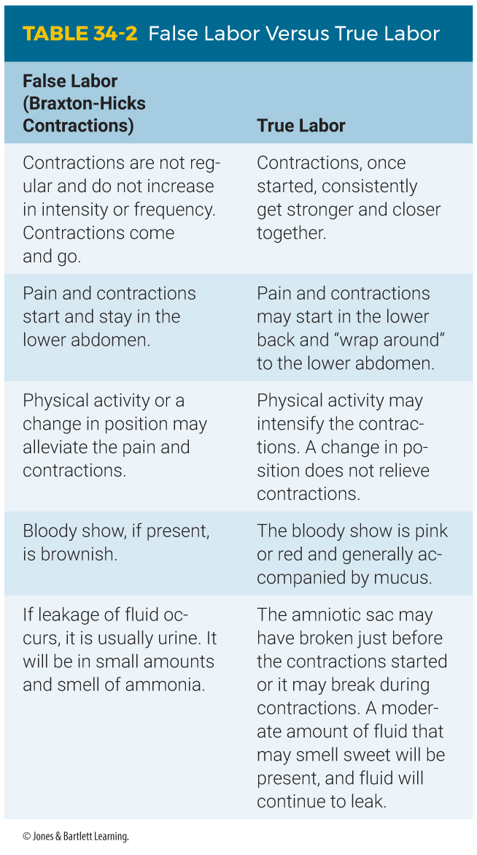
First Stage (3 of 4)
Notes:
The table on this slide shows how to distinguish between true labor and false labor (Braxton-Hicks Contractions)

Slide 70
First Stage (4 of 4)
Some women experience a premature rupture of the amniotic sac.
  Patient may or may not go into labor.
  Provide supportive care and transport.
The head of the fetus descends into the woman’s pelvis as it positions for delivery.
  This descent is called lightening.
Notes:
Lecture Outline
5. Some women experience a premature rupture of the membranes, in which the amniotic sac ruptures too early and the fetus is not developed or ready to be born.
a. The patient may or may not go into labor.
b. You will need to provide supportive care and transport to the hospital.
6. Toward the end of the third trimester, the head of the fetus normally descends into the woman’s pelvis as the fetus positions for delivery.
a. This movement down into the pelvis and the sensation that may accompany the descent is called lightening.

Slide 71
Second Stage
Begins when the fetus begins to encounter the birth canal
  Ends when the newborn is born
  Uterine contractions are usually closer together and last longer.
  The perineum will bulge significantly, and the top of the fetus’s head will appear at the vaginal opening (crowning).
Notes:
Lecture Outline
C. The second stage of labor begins when the fetus begins to encounter the birth canal and ends with delivery of the newborn (spontaneous birth).
1. Make a decision about helping the woman to deliver at the scene or providing transport to the hospital.
2. Uterine contractions are usually closer together and last longer.
3. The perineum will begin to bulge significantly, and the top of the fetus’s head should begin to appear at the vaginal opening (crowning).

Slide 72
Third Stage
Begins with the birth of the newborn and ends with the delivery of the placenta
  The placenta must completely separate from the uterine wall.
  May take up to 30 minutes
Notes:
Lecture Outline
D. The third stage of labor begins with the birth of the newborn and ends with the delivery of the placenta.
1. During this stage, the placenta must completely separate from the uterine wall.
2. This may take up to 30 minutes.

Slide 73
Preparing for Delivery (1 of 10)
Consider delivery at the scene when:
  Delivery is imminent (will occur within a few minutes)
  A natural disaster, inclement weather, or other environmental factor makes it impossible to reach the hospital.
Notes:
Lecture Outline
X. Normal Delivery Management
A. Preparing for delivery
1. Consider delivery at the scene when:
a. Delivery is imminent (will occur within a few minutes)
b. A natural disaster, inclement weather, or other environmental factor makes it impossible to reach the hospital

Slide 74
Preparing for Delivery (2 of 10)
To determine if delivery is imminent, ask the patient:
  How long have you been pregnant?
  When are you due?
  Is this your first baby?
  Are you having contractions?
    How far apart?
    How long do they last?
Notes:
Lecture Outline
2. To determine if delivery is imminent, ask the patient the following questions:
a. How long have you been pregnant?
b. When are you due?
c. Is this your first pregnancy?
d. Are you having contractions?
i. How far apart are they?
ii. How long do they last?

Slide 75
Preparing for Delivery (3 of 10)
To determine if delivery is imminent, ask the patient (cont’d):
  Have you had spotting or bleeding?
  Has your water broken?
  Do you feel as though you need to have a bowel movement?
  Do you feel the need to push?
Notes:
Lecture Outline
e. Have you had any spotting or bleeding?
f. Has your water broken?
g. Do you feel as though you need to have a bowel movement?
h. Do you feel the need to push?

Slide 76
Preparing for Delivery (4 of 10)
To determine potential complications, ask:
  Were any of your previous deliveries by cesarean section?
  Have you had problems in this or any previous pregnancies?
  Do you use drugs, drink alcohol, or take any medications?
  Is there a chance of multiple deliveries?
  Does your physician expect complications?
Notes:
Lecture Outline
3. To help determine potential complications, ask these questions:
a. Were any of your previous deliveries by cesarean section?
b. Have you had problems in this or any previous pregnancies?
c. Do you use drugs, drink alcohol, or take any medications?
d. Do you know if there is a chance you will have multiple deliveries?
e. Does your physician expect any complications?

Slide 77
Preparing for Delivery (5 of 10)
If the patient says that she is about to deliver, she has to move her bowels, or feels the need to push, you should prepare for delivery.
  Visually inspect the vagina to check for crowning.
  Do not touch the vaginal area unless delivery is imminent
Notes:
Lecture Outline
4. If the patient says that she is about to deliver, says she has to move her bowels, or feels the need to push, you should immediately prepare for delivery.
a. Visually inspect the vagina to check for crowning.
b. Do not touch the vaginal area until you have determined that delivery is imminent.

Slide 78
Preparing for Delivery (6 of 10)
Once labor has begun, it cannot be slowed or stopped.
  Never attempt to hold the patient’s legs together.
  Do not let her go to the bathroom.
Remember, if you deliver at the scene, you are only assisting the woman with the delivery.
Notes:
Lecture Outline
5. Once labor has begun, it cannot be slowed or stopped.
a. Never attempt to hold the patient’s legs together.
b. Do not let her go to the bathroom.
c. Instead, reassure her that the sensation of needing to move her bowels is normal and that it means she is about to deliver.
6. If your decision is to deliver at the scene, remember that you are only assisting the woman with the delivery.
a. Your part is to help, guide, and support the baby as it is born.

Slide 79
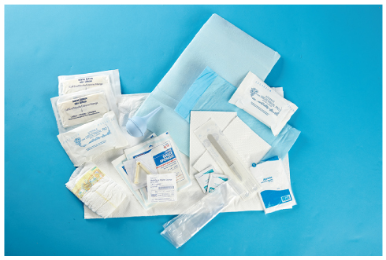
Preparing for Delivery (7 of 10)
Your emergency vehicle should always be equipped with a sterile emergency obstetric (OB) kit.
FIGURE 34-6 Your unit should contain a sterile obstetric kit.
© Jones & Bartlett Learning.
Notes:
Lecture Outline
7. Your emergency vehicle should always be equipped with a sterile emergency obstetric (OB) kit, including:

Slide 80
Preparing for Delivery (8 of 10)
Patient position
  Preserve the patient’s privacy.
  Place the patient on a firm surface padded with blankets, sheets, and towels.
  Elevate the hips about 2 to 4 inches.
  Support the head, neck, and upper back.
  Have her keep her legs and hips flexed, with her feet flat and her knees spread apart.
Notes:
Lecture Outline
8. Patient position
a. The patient’s clothing should be removed or pushed up to her waist, and pants and undergarments should be removed.
b. Preserve the patient’s privacy as much as possible.
c. Place the patient on a firm surface that is padded with blankets, folded sheets, or towels.
d. Elevate the hips about 2 to 4 inches with a pillow or blankets.
e. Support the head, neck, and upper back with pillows and blankets.
f. Have her keep her legs and hips flexed, with her feet flat on the surface beneath her and her knees spread apart.

Slide 81
Preparing for Delivery (9 of 10)
Preparing the delivery field
  Place towels or sheets on the floor around the delivery area.
  Open the OB kit carefully.
  Put on sterile gloves.
  Use the sterile sheets and drapes from the OB kit to make a sterile delivery field.
Notes:
Lecture Outline
9. Preparing the delivery field
a. Put on a protective face shield and gown. As time allows, place towels or sheets on the floor around the delivery area to help soak up body fluids and to protect the woman and the newborn.
b. Open the OB kit carefully so that its contents remain sterile.
c. Use the sterile sheets and drapes from the OB kit to make a sterile delivery field.

Slide 82
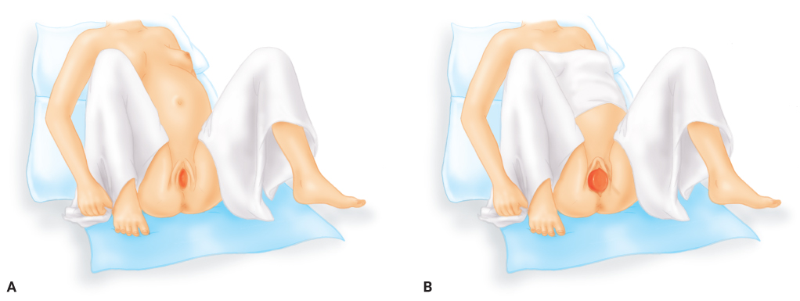
Preparing for Delivery (10 of 10)
FIGURE 34-7 Preparing the delivery field. A. Use sterile sheets and drapes from the OB kit to make a clean delivery field. Place one sheet under the woman’s buttocks. Wrap another sheet behind her back with either end draped over the thighs.
B. Drape another sheet over the woman’s abdomen
A, B: © Jones & Bartlett Learning.
Notes:
The figures on this slide show how to prepare the delivery field.

Slide 83
Delivery (1 of 6)
Your partner should be at the patient’s head to comfort, soothe, and reassure.
If the patient will allow it, apply oxygen.
Continually check for crowning.
  Some patients experience precipitous labor and birth.
  Position yourself so that you can see the perineal area at all times.
Notes:
Lecture Outline
B. Delivery
1. Your partner should be at the patient’s head to comfort, soothe, and reassure her during the delivery.
2. If the patient will allow it, administer oxygen.
3. It is common for patients to become nauseated during delivery, and some may vomit.
4. Continually check the patient for crowning.
a. Some patients may experience precipitous labor and birth.
b. Position yourself so that you can see the perineal area at all times.

Slide 84
Delivery (2 of 6)
Time the patient’s contractions.
  Remind the patient to take quick, short breaths during each contraction but not to strain.
  Between contractions, encourage the patient to rest and breathe deeply through her mouth.
Delivering the head
  Observe the head as it exits the vagina.
  Support the head with your gloved hand as it rotates.
Notes:
Lecture Outline
c. Time the patient’s contractions.
d. Remind the patient to take quick, short breaths during each contraction but not to strain.
e. Between contractions, encourage the patient to rest and breathe deeply through her mouth.
5. Follow the steps in Skill Drill 34-1 to deliver the newborn.
6. Delivering the head
a. Observe the head as it begins to exit the vagina so you can provide support as it emerges.
b. Place your sterile gloved hand over the emerging bony parts of the head to control the delivery of the head.
c. Continue to support the head as it rotates.

Slide 85
Delivery (3 of 6)
Delivering the head (cont’d)
  Apply gentle pressure across the perineum with a sterile gauze pad to reduce the risk of perineal tearing.
  Be prepared for the possibility of the patient having a bowel movement.
  Do not poke your fingers into the newborn’s eyes or fontanelles.
Notes:
Lecture Outline
d. Be careful that you do not poke your fingers into the newborn’s eyes or into the fontanelles.

Slide 86
Delivery (4 of 6)
Unruptured amniotic sac
  If the amniotic sac does not rupture by the time the head is crowning, it will appear as a fluid-filled sac emerging from the vagina.
  It will suffocate the fetus if not removed.
  You may puncture the sac with a clamp or tear it by twisting it between your fingers.
  Clear the newborn’s mouth and nose immediately.
Notes:
Lecture Outline
7. Unruptured amniotic sac
a. Usually, the amniotic sac will rupture at the beginning of labor or during contractions.
b. If it has not ruptured by the time the fetal head is crowning, it will appear as a fluid-filled sac emerging from the vagina.
c. The sac will suffocate the fetus if it is not removed.
d. You may puncture the sac with a clamp or tear it by twisting it between your fingers.
e. Make sure that the puncture site is away from the fetus’s face and only perform this procedure as the head is crowning.
f. Clear the newborn’s mouth and nose, using the bulb syringe if required by your protocols, and wipe the mouth and nose with gauze.

Slide 87
Delivery (5 of 6)
Umbilical cord around the neck
  As soon as the head is delivered, use one finger to feel whether the umbilical cord is wrapped around the neck.
  Usually, you can slip the cord gently over the delivered head.
  If not, you must cut it.
  Once the cord is cut, attempt to speed delivery.
Notes:
Lecture Outline
8. Umbilical cord around the neck
a. As soon as the head is delivered, use one finger to feel whether the umbilical cord is wrapped around the neck (nuchal cord).
b. Usually, you can slip the cord gently over the delivered head.
c. If not, you must cut it.

Slide 88
Delivery (6 of 6)
Delivering the body
  Once the head is born, the body usually delivers easily.
  Support the head and upper body as the shoulders deliver.
  Do not pull the fetus from the birth canal.
  The newborn will be slippery and covered in vernix caseosa.
Notes:
Lecture Outline
9. Delivering the body
a. The head is the largest part of the fetus.
i. Once it is born, the body usually delivers easily.
b. Support the head and upper body as the shoulders deliver.
c. Do not pull the fetus from the birth canal.
d. The newborn will be slippery and may be covered with a white, cheesy substance, called vernix caseosa.

Slide 89
Postdelivery Care (1 of 5)
If the mother is able and willing, place the newborn on her abdomen so skin-to-skin contact can begin immediately.
Dry off the newborn and wrap him or her in a blanket or towel.
Wrap the newborn so only the face is exposed.
Notes:
Lecture Outline
C. Postdelivery care
1. If the mother is able and willing, hand the newborn to her or place the newborn on her abdomen so skin-to-skin contact can begin immediately.
2. Dry off the newborn and wrap him or her in a warm blanket or towel.
a. Wrap the newborn in a clean blanket or towel to maintain warmth.
b. Ensure the top of the head is covered.
3. Keep the neck of the newborn in a neutral position.

Slide 90
Postdelivery Care (2 of 5)
Wipe the mouth with a sterile gauze pad as needed.
Clamp and cut the umbilical cord after approximately 60 seconds.
Obtain the 1-minute Apgar score.
Notes:
Lecture Outline
Wipe the newborn’s mouth with a sterile gauze pad as needed.
5. Clamp and cut the umbilical cord after approximately 60 seconds.
6. Obtain the 1-minute Apgar score.

Slide 91
Postdelivery Care (3 of 5)
Delivery of the placenta
  Your job is only to assist.
  The placenta delivers itself, usually within a few minutes of the birth.
  Never pull on the end of the umbilical cord.
Notes:
Lecture Outline
7. Delivery of the placenta
a. The placenta delivers itself, usually within a few minutes of the birth, although it may take as long as 30 minutes.

Slide 92
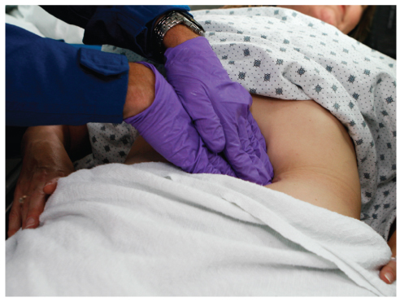
Postdelivery Care (4 of 5)
You can help to slow bleeding by gently massaging the woman’s abdomen with a firm, circular, “kneading” motion.
FIGURE 34-9 After delivery, massage the woman’s abdomen in a firm, circular motion.
© Jones & Bartlett Learning.
Notes:
Lecture Outline
b. After delivery of the placenta and before transport, place a sterile pad or sanitary napkin over the vagina and straighten the woman’s legs.
i. You can help to slow bleeding by gently massaging the woman’s abdomen with a firm, circular, kneading motion with one hand cupped over the top of the fundus and the other above the pubic bone.

Slide 93
Postdelivery Care (5 of 5)
Record the time of birth in your patient care report.
The following are emergency situations:
  More than 30 minutes elapse and the placenta has not delivered
  There is more than 500 mL of bleeding before delivery of the placenta.
  There is significant bleeding after the delivery of the placenta.
Notes:
Lecture Outline
c. Record the time of birth in your patient care report.
d. The following are emergency situations:
i. More than 30 minutes elapse and the placenta has not delivered.
ii. There is more than 500 mL of bleeding before delivery of the placenta.
iii. There is significant bleeding after the delivery of the placenta.
e. If one or more of these events occur, transport the woman and the newborn to the hospital promptly.

Slide 94
Neonatal Assessment and Resuscitation (1 of 3)
The first minute after birth is the “golden minute.”
During this time perform the initial steps of newborn care:
  Airway positioning and suctioning, if needed
  Drying
  Warming
  Tactile stimulation
Notes:
Lecture Outline
XI. Neonatal Assessment and Resuscitation
A. The first minute after birth is often referred to as the “golden minute”.
1. During the first minute of life, perform the following initial steps of newborn care:
a. Airway positioning and suctioning, if needed
b. Drying
c. Warming
d. Tactile stimulation

Slide 95
Neonatal Assessment and Resuscitation (2 of 3)
Normally the newborn will begin breathing within 30 seconds after birth, and the heart rate will be 100 beats/min or higher.
  If not, positive pressure ventilation may be needed
Many newborns require some form of stimulation, including:
  Positioning the airway, drying, warming, suctioning, or tactile stimulation
Notes:
Lecture Outline
2. Normally the newborn will begin breathing within 30 seconds after birth, and the heart rate will be 100 beats/min or higher.
3. Many newborns require some form of stimulation that will encourage them to breathe air and begin circulating blood through the lungs, including:
a. Position the airway in a neutral or sniffing position
b. If necessary, then suction the mouth and then the nose
c. Vigorously dry the head, body, and back
d. Rub the newborn’s back and gently flick or slap the soles of his or her feet
e. Tactile stimulation
4. If signs of good tone and adequate ventilation are not present after performing the initial steps for 30 seconds, then positive pressure ventilation with a mask may be necessary.

Slide 96
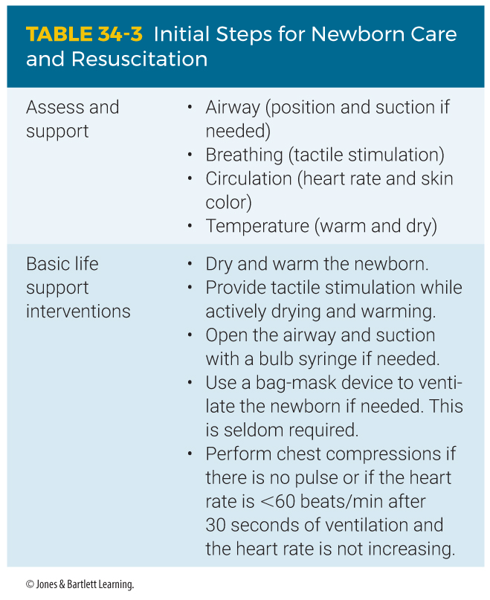
Neonatal Assessment and Resuscitation (3 of 3)
Notes:
The table on this slide shows how to perform resuscitation for a newborn who is not breathing.

Slide 97
Additional Resuscitation Efforts (1 of 4)
Observe the newborn for spontaneous respirations, skin color, and movement of the extremities.
Evaluate the heart rate at the base of the umbilical cord or brachial artery or by listening to the newborn’s chest with a stethoscope.
Notes:
Lecture Outline
B. Additional resuscitation efforts
1. Observe the newborn for spontaneous respirations, skin color, and movement of the extremities.
2. Evaluate the heart rate by palpating the pulse at the base of the umbilical cord or at the brachial artery or listening to the newborn’s chest with a stethoscope.
a. The heart rate is the most important measure in determining the need for further resuscitation.

Slide 98
Additional Resuscitation Efforts (2 of 4)
If chest compressions are required, use the hand-encircling technique for two-person resuscitation.
  Perform bag-mask ventilation during a pause after every third compression, using a ratio of 3:1.
  120 actions per minute (90 compressions and 30 ventilations)
  Hands-only CPR is not as effective as ventilation with CPR.
Notes:
Lecture Outline
3. If chest compressions are required, use the hand-encircling technique for two-person resuscitation.
a. Perform bag-mask ventilation during a pause after every third compression, using a compression-to-ventilation ration of 3:1. Hands-only CPR is not as effective as ventilation with CPR.

Slide 99
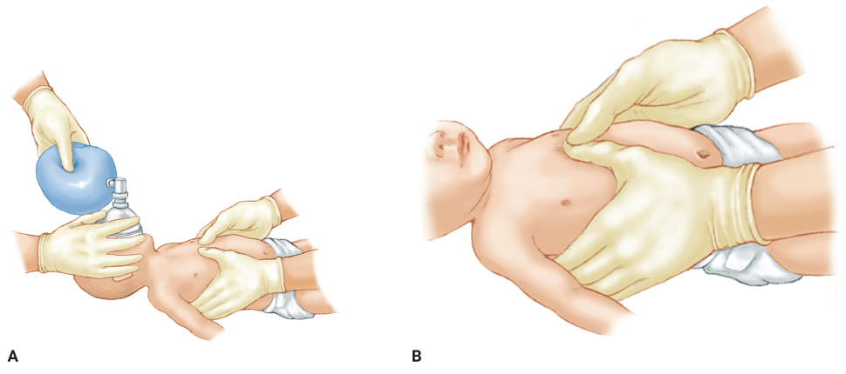
Additional Resuscitation Efforts (3 of 4)
FIGURE 34-11 A. Chest compressions should be given with the hands encircling the newborn and thumbs side by side. B. In very small newborns, you may need to overlap the thumbs.
A, B: © Jones & Bartlett Learning.
Notes:
The figures on this slide show how to give chest compressions to a newborn using the hand-encircling technique.

Slide 100
Additional Resuscitation Efforts (4 of 4)
If meconium is present and the newborn is not breathing:
  Quickly suction the newborn’s mouth then nose after delivery before providing rescue ventilations.
Notes:
Lecture Outline
4. If you see meconium in the amniotic fluid or meconium staining and the newborn is not breathing adequately, consider quickly suctioning the newborn’s mouth then nose after delivery before providing rescue ventilations.

Slide 101
The Apgar Score (1 of 5)
Standard scoring system used to assess the status of a newborn
Assigns a number value to five areas:
  Appearance
  Pulse
  Grimace or irritability
  Activity or muscle tone
  Respirations
Notes:
Lecture Outline
C. The Apgar score
1. The Apgar score is the standard scoring system used to assess the status of a newborn.
2. It assigns a number value (0, 1, or 2) to five areas of activity.
a. Appearance
b. Pulse
c. Grimace or irritability
d. Activity or muscle tone
e. Respirations

Slide 102
The Apgar Score (2 of 5)
The total of the five numbers is the Apgar score.
  A perfect score is 10.
  Calculate the Apgar score at 1 minute and 5 minutes after birth.
Notes:
Lecture Outline
3. The total of the five numbers is the Apgar score.
a. Calculate the Apgar score at 1 minute and 5 minutes after birth.
b. The highest possible Apgar score is 10

Slide 103
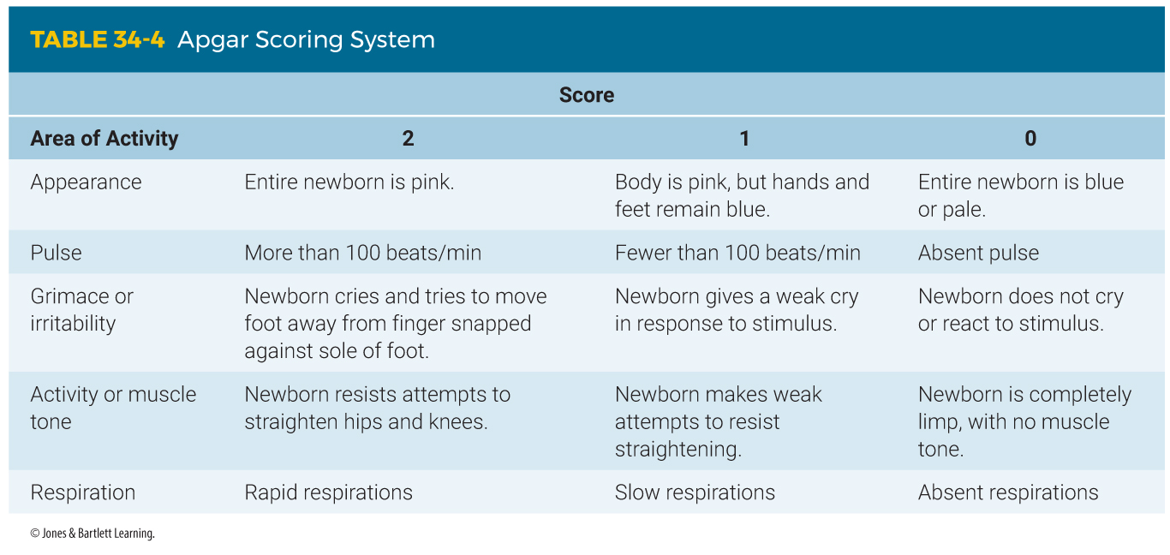
The Apgar Score (3 of 5)
Notes:
The table on this slide shows how to calculate the Apgar score for a newborn.

Slide 104
The Apgar Score (4 of 5)
Assessing a newborn
  Calculate the Apgar score.
  Stimulation should result in an immediate increase in respirations.
  If the newborn is breathing well, assess the pulse.
  Assess oxygenation via pulse oximetry and observe for central cyanosis.
Notes:
Lecture Outline
4. Steps for assessing a newborn:
a. Quickly calculate the Apgar score to establish a baseline of the newborn’s status.
b. Stimulation should result in an immediate increase in respiration rate.
i. If not, you must begin ventilations with a bag-mask device.
c. If the newborn is breathing well, you should next check the pulse rate by feeling the brachial pulse or the pulsations at the base of the umbilical cord or auscultating the chest with a stethoscope.
i. The pulse rate should be at least 100 beats/min.
ii. If it is not, begin ventilations with a bag-mask device.
iii. Reassess respirations and heart rate at least every 30 seconds.
d. Assess the newborn’s oxygenation via pulse oximetry, which is best taken at the right wrist, and observe for central cyanosis.
i. If present, administer blow-by oxygen by holding oxygen tubing at high-flow close to the newborn’s face.
ii. Set oxygen flow rate to 5 L/min.

Slide 105
The Apgar Score (5 of 5)
Request a second unit if the newborn is in distress and will require resuscitation.
In situations where assisted ventilation is required, use a newborn bag-mask device.
If the newborn does not begin breathing on his or her own or does not have an adequate heart rate, continue CPR and rapidly transport.
Notes:
Lecture Outline
e. Request a second unit as soon as possible if you determine that the newborn is in any distress and will require resuscitation.
5. In situations where assisted ventilation is required, you should use a newborn bag-mask device.
a. Make sure you have a good mask-to-face seal.
b. Using gentle pressure, make the chest rise with each ventilation.
6. If the newborn does not begin breathing on his or her own or does not have an adequate heart rate, continue CPR and rapidly transport.
a. Once CPR has been started, do not stop until the newborn responds or is pronounced dead by a physician.

Slide 106
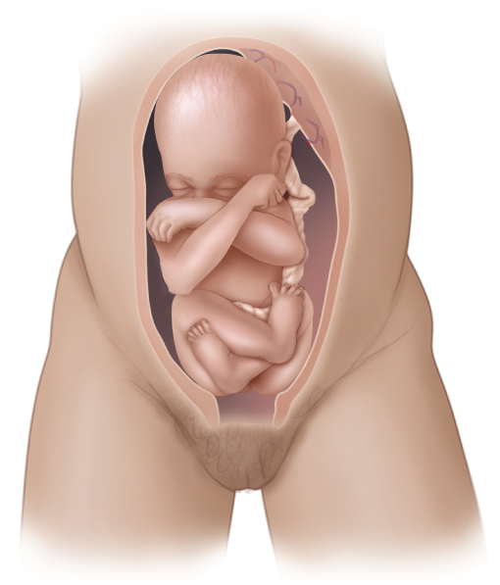
Breech Delivery (1 of 4)
Most infants are born headfirst.
Occasionally, the buttocks are delivered first.
Called a breech presentation
FIGURE 34-13 In a breech presentation, the buttocks are delivered first. Breech deliveries are usually slow, so you will often have time to transport the woman to the hospital.
© Jones & Bartlett Learning.
Notes:
Lecture Outline
XII. Complicated Delivery Emergencies
A. Breech delivery
1. The presentation is the position in which an infant is born or the body part that is delivered first.
2. Most infants are born headfirst, called a vertex presentation.
3. Occasionally, the buttocks are delivered first, called a breech presentation.
a. The fetus is at great risk for trauma from the delivery.
b. Prolapsed cords are more common in a breech delivery.

Slide 107
Breech Delivery (2 of 4)
Breech deliveries usually take longer, so you will often have time to transport the pregnant woman to the hospital.
  If the buttocks have passed through the vagina, the delivery has begun.
  Provide emergency care and call for ALS backup.
  Consult medical control to guide you.
Notes:
Lecture Outline
4. Breech deliveries usually take longer, so you will often have time to transport the pregnant woman to the hospital.
a. However, if the buttocks have already passed through the vagina, the delivery has begun.

Slide 108
Breech Delivery (3 of 4)
Preparing for a breech delivery is the same as for a normal childbirth.
  Position the pregnant woman.
  Prepare the OB kit.
  Place yourself and your partner as you would normally.
  Allow the buttocks and legs to deliver spontaneously, supporting them with your hand.
Notes:
Lecture Outline
5. Preparing for a breech delivery is the same as for a normal childbirth.
a. Allow the buttocks and legs to deliver spontaneously, supporting them with your hand to prevent rapid expulsion.
b. Let the legs dangle on either side of your arm while you support the trunk and chest as they are delivered.

Slide 109
Breech Delivery (4 of 4)
Preparing for a breech delivery (cont’d)
  The head is almost always facedown and should be allowed to deliver spontaneously.
  Make a “V” with your gloved fingers and position them in the vagina to keep the walls from compressing the fetus’s airway.
Notes:
Lecture Outline
c. The head is almost always facedown and should be allowed to deliver spontaneously.
d. Make a “V” with your gloved fingers and position them in the vagina to keep the walls of the vagina from compressing the fetus’s airway.

Slide 110
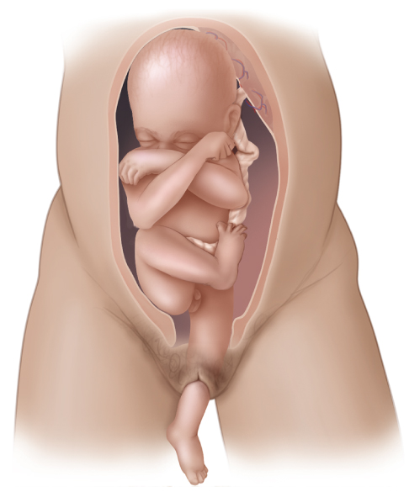
Presentation Complications (1 of 4)
On rare occasions, the presenting part of the fetus is a single arm, leg, or foot.
  Called a limb presentation
FIGURE 34-14 In rare cases, a limb, usually a single arm or leg, presents first. This is a life-threatening situation, and you must provide prompt transport for hospital delivery.
© Jones & Bartlett Learning.
Notes:
Lecture Outline
B. Presentation complications
1. On rare occasions, the presenting part of the fetus is neither the head nor the buttocks, but a single arm, leg, or foot.
a. This is called a limb presentation.

Slide 111
Presentation Complications (2 of 4)
A fetus with a limb presentation cannot be delivered in the field.
  Usually surgery is needed.
  Transport immediately.
  If a limb is protruding, cover it with a sterile towel.
  Never try to push it in or pull on it.
  Place the patient on her back, with her head down and pelvis elevated.
Notes:
Lecture Outline
b. An infant with a limb presentation cannot be successfully delivered in the field.
c. You must transport the patient to the hospital immediately.
d. If a limb is protruding, cover it with a sterile towel.
e. Never try to push it back in, and never pull on it.
f. Place the patient on her back, with her head down and pelvis elevated.

Slide 112
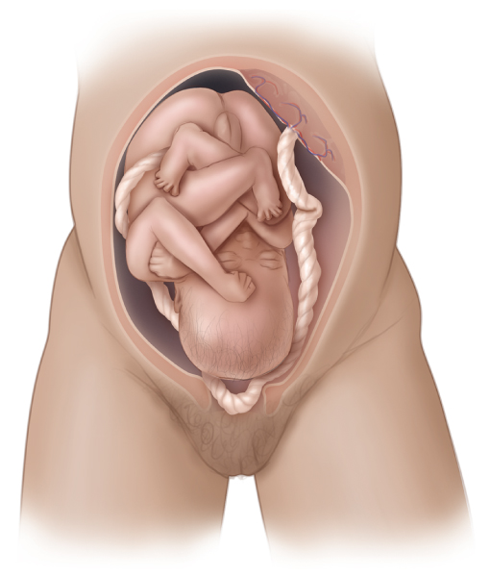
Presentation Complications (3 of 4)
Prolapse of the umbilical cord must be treated in the hospital.
  The umbilical cord comes out of the vagina before the fetus.
FIGURE 34-15 A prolapsed umbilical cord is a
life-threatening situation for the fetus and must be treated at the hospital.
© Jones & Bartlett Learning.
Notes:
Lecture Outline
3. Prolapse of the umbilical cord, where the umbilical cord comes out of the vagina before the fetus, must be treated in the hospital.

Slide 113
Presentation Complications (4 of 4)
The fetus’s head will compress the cord and cut off circulation.
  Do not push the cord back into the vagina.
  Insert your gloved hand into the vagina and push the fetus’s head away from the umbilical cord.
  Place the pregnant woman supine with the foot of the cot raised higher than the head, with her hips elevated or in the knee-chest position.
  Transport rapidly.
Notes:
Lecture Outline
a. Do not attempt to push the cord back into the vagina.
b. Your job is to try to keep the fetus’s head from compressing the cord.
c. Carefully insert your sterile gloved hand into the vagina, and gently push the fetus’s head away from the umbilical cord.
d. Place the woman supine with the foot of the stretcher raised 6 to 12 inches higher than her head, with her hips elevated on a pillow or folded sheet.
i. Alternatively, the woman may be placed in the knee-chest position.
e. Wrap a sterile towel, moistened with saline, around the exposed cord.
f. Give the patient high-flow oxygen and transport rapidly.

Slide 114
Spina Bifida
Developmental defect in which a portion of the spinal cord or meninges may protrude outside of the vertebrae
  Cover the open area of the spinal cord with a sterile, moist dressing.
  Maintenance of body temperature is important when applying moist dressings.
Notes:
Lecture Outline
C. Spina bifida
1. A developmental defect in which a portion of the spinal cord or meninges may protrude outside of the vertebrae and possibly outside of the body.
a. Cover the open area of the spinal cord with a sterile, moist dressing immediately after birth to help prevent a potentially fatal infection.
b. Maintenance of the newborn’s body temperature is important when applying moist dressings because the moisture can lower the newborn’s body temperature.

Slide 115
Multiple Gestation (1 of 2)
Twins occur once in every 30 births.
Twins are smaller than single fetuses, and delivery is typically not difficult.
  About 10 minutes after the first birth, contractions will begin again, and the birth process will repeat itself.
  Second one is usually born within 45 minutes of the first.
Notes:
Lecture Outline
D. Multiple gestation
1. Twins occur about once in every 30 births.
2. Twins are usually smaller than single fetuses, and delivery is typically not difficult.
a. About 10 minutes after the first birth, contractions will begin again, and the birth process will repeat itself.

Slide 116
Multiple Gestation (2 of 2)
The procedure is the same as that for a single fetus.
Record the time of birth of each twin separately.
Twins may be so small that they look premature.
Notes:
Lecture Outline
3. The procedure for delivering twins is the same as that for a single fetus; however, you will need some supplies from an additional OB kit.
a. Clamp and cut the cord of the first newborn as soon as it has been born and before the second newborn is delivered.
4. Record the time of birth of each twin separately.
5. Twins may be so small that they look premature.

Slide 117
Premature Birth (1 of 3)
A normal, full-term, single newborn will weigh about 7 lb at birth.
Any newborn who delivers before 8 months (36 weeks) or weighs less than 5 lb at birth is considered premature.
Notes:
Lecture Outline
F. Premature birth
1. Any newborn who delivers before 8 months (36 weeks) or weighs less than 5 lb at birth is considered premature.

Slide 118
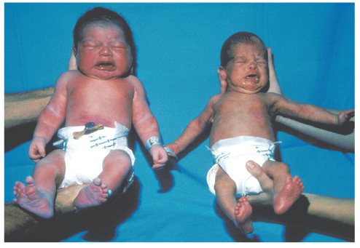
Premature Birth (2 of 3)
A premature newborn is smaller and thinner, and the head is proportionately larger.
  The vernix caseosa will be absent or minimal.
  There will be less body hair.
FIGURE 34-16 Premature newborns (right) are smaller and thinner than full-term newborns.
© American Academy of Orthopaedic Surgeons.
Notes:
Lecture Outline
3. A premature newborn is smaller and thinner than a full-term newborn, and the head is proportionately larger in comparison with the rest of the body.
a. The vernix caseosa will be absent or minimal on the premature newborn.
b. There will also be less body hair.

Slide 119
Premature Birth (3 of 3)
Premature newborns require special care to survive.
  Often require resuscitation efforts, which should be performed unless it is physically impossible
  With such care, premature newborns as small as 1 lb have survived and developed normally.
Notes:
Lecture Outline
4. Premature newborns require special care to survive.
a. They often require resuscitation efforts, which should be performed unless it is physically impossible.
b. With such care, premature newborns as small as 1 lb have survived and developed normally.

Slide 120
Postterm Pregnancy (1 of 2)
Pregnancies lasting longer than 41 weeks
Fetuses can be larger, sometimes weighing 10 lb or more.
Can lead to problems with the woman and fetus
  A more difficult labor and delivery
Notes:
Lecture Outline
F. Postterm pregnancy
1. Postterm pregnancy refers to pregnancies lasting longer than 41 weeks.
2. Postterm fetuses can be larger than a typical 40-week fetus, sometimes weighing 10 lb or more.
3. The larger size can lead to problems with the woman and fetus.
a. A more difficult labor and delivery

Slide 121
Postterm Pregnancy (2 of 2)
Problems (cont’d):
  Increased chance of injury to the fetus
  Increased likelihood of cesarean section
  Woman is at risk for perineal tears and infection.
  Postterm newborns have increased risks of meconium aspirations, infection, and being stillborn.
  Newborns may not have developed normally.
Notes:
Lecture Outline
b. Increased chance of injury to the fetus
c. Increased likelihood of cesarean section being required
d. Woman is at risk for perineal tears and infection
e. Postterm newborns have increased risks of meconium aspiration, infection, and being stillborn.
f. Newborns may not have been able to develop normally because of the restricted size of the uterus.
4. Be prepared to resuscitate the newborn, as respiratory and neurologic functions may have been affected.

Slide 122
Fetal Demise
You may deliver a fetus who died in the woman’s uterus before labor.
  Onset of labor may be premature, but labor will progress normally in most cases.
  If an intrauterine infection caused the demise, you may note a foul odor.
  Do not attempt to resuscitate an obviously dead neonate.
Notes:
Lecture Outline
H. Fetal demise
1. The onset of labor may be premature, but labor will otherwise progress normally in most cases.
2. If an intrauterine infection has caused the demise, you may note an extremely foul odor.
a. The delivered fetus may have skin blisters, skin sloughing, and a dark discoloration.
b. The head will be soft and perhaps grossly deformed.
3. Do not attempt to resuscitate an obviously dead neonate.

Slide 123
Postpartum Complications (1 of 3)
If bleeding continues after delivery of the placenta:
  Continue to massage the uterus.
  Check your technique and hand placement if bleeding continues.
  Excessive bleeding is usually caused by the uterine muscles not fully contracting.
Notes:
Lecture Outline
XIII. Postpartum Complications
A. Bleeding that exceeds approximately 1,000 mL is considered excessive.
1. If bleeding continues after delivery of the placenta, you should continue to massage the uterus.
2. Treat signs and symptoms of shock.
3. Excessive bleeding after birth is usually caused by the muscles of the uterus not fully contracting and is potentially life-threatening.

Slide 124
Postpartum Complications (2 of 3)
Cover the vagina with a sterile pad.
  Change the pad as often as possible.
  Do not discard any blood-soaked pads.
Administer oxygen, monitor vital signs, and transport the patient immediately.
Notes:
Lecture Outline
4. Cover the vagina with a sterile pad, changing the pad as often as possible.
5. Administer oxygen if necessary, monitor vital signs frequently, and transport the patient immediately to the hospital.
a. Never hold the woman’s legs together or pack the vagina with gauze pads in an attempt to control bleeding.
b. Never pack the vagina with gauze pads in an attempt to control bleeding

Slide 125
Postpartum Complications (3 of 3)
Postpartum patients are at an increased risk of an embolism.
  Most commonly a pulmonary embolism
  Results from a clot that travels through the bloodstream and becomes lodged in the pulmonary circulation
  Consider when a woman complains of sudden difficulty breathing or shortness of breath following delivery
Notes:
Lecture Outline
B. Postpartum patients are also at an increased risk of a venous embolism—most commonly a pulmonary embolism.
1. A pulmonary embolism results from a clot that travels through the bloodstream and becomes lodged in the pulmonary circulation, blocking blood flow to the lungs, and is potentially life threatening.
2. This obstruction will block blood flow to the lungs and is potentially life threatening.
3. If you deliver a newborn in the field and the woman begins to report sudden difficulty breathing or shortness of breath, consider pulmonary embolism as a possibility.
4. Also suspect a pulmonary embolism in patients of childbearing age with respiratory complaints who have recently delivered, especially with the sudden onset of difficulty breathing or altered mental status.

Slide 126
Review
The first stage of labor ends when:
  the presenting part of the baby is visible.
  contractions are less than 10 minutes apart.
  the mother experiences her first contraction.
  the amniotic sac ruptures and labor pains begin.

Slide 127
Review
Answer: A
Rationale: The first stage of labor begins with the onset of contractions and ends when the cervix is fully dilated. However, since cervical dilation cannot be assessed in the field, the first stage of labor is considered over when the presenting part of the baby is visible at the vaginal opening (crowning).

Slide 128
Review
The first stage of labor ends when:
  the presenting part of the baby is visible.
  Rationale: Correct answer
  contractions are less than 10 minutes apart.
  Rationale: True labor is when the frequency and intensity of contractions increase and is part of the first stage of labor.
  the mother experiences her first contraction.
  Rationale: This is the beginning of the first stage of labor.
  the amniotic sac ruptures and labor pains begin.
  Rationale: This is considered to be a part of the first stage of labor.

Slide 129
Review
A 23-year-old woman, who is 24 weeks pregnant with her first baby, complains of edema to her hands, a headache, and visual disturbances. When you assess her vital signs, you note that her blood pressure is 160/94 mm Hg. She is MOST likely experiencing:
  eclampsia.
  preeclampsia.
  a hypertensive crisis.
  chronic water retention.

Slide 130
Review
Answer: B
Rationale: Preeclampsia—also called pregnancy-induced hypertension—usually develops after the 20th week of gestation and most commonly affects primigravida (first pregnancy) patients. It is characterized by a headache, visual disturbances, edema of the hands and feet, anxiety, and high blood pressure. Preeclampsia can lead to eclampsia, a life-threatening condition that is characterized by seizures.

Slide 131
Review
A 23-year-old woman, who is 24 weeks pregnant with her first baby, complains of edema to her hands, a headache, and visual disturbances. When you assess her vital signs, you note that her blood pressure is 160/94 mm Hg. She is MOST likely experiencing:
  eclampsia.
  Rationale: Eclampsia is a seizure that results from severe hypertension.
  preeclampsia.
  Rationale: Correct answer
  a hypertensive crisis.
  Rationale: This is a severe, sudden increase in blood pressure, typically greater than 110 diastolic, that can lead to a stroke.
  chronic water retention.
  Rationale: This is fluid imbalance usually caused by too much sodium in the body.

Slide 132
Review
You are transporting a woman who is 8 months’ pregnant. To prevent supine hypotensive syndrome, how should you position this patient?
  On her right side
  Supine
  Semi-Fowler
  On her left side

Slide 133
Review
Answer: D
Rationale: To prevent supine hypotensive syndrome, the patient must be positioned on her left side. This stops the weight of the fetus from compressing the inferior vena cava, which can cause low blood pressure.

Slide 134
Review
You are transporting a woman who is 8 months’ pregnant. To prevent supine hypotensive syndrome, how should you position this patient?
  On her right side
  Rationale: The patient should be transported on her left side.
  Supine
  Rationale: Lying the patient supine will cause hypotension.
  Semi-Fowler
  Rationale: The patient should be transported on her left side.
  On her left side
  Rationale: Correct answer

Slide 135
Review
Immediately after delivery of the infant’s head, you should:
  suction the baby’s mouth and then nose.
  suction the baby’s nose and then mouth.
  assess the baby’s breathing effort and skin color.
  check the position of the umbilical cord.

Slide 136
Review
Answer: D
Rationale: Immediately following delivery of the infant’s head, you should check the position of the umbilical cord to make sure it is not wrapped around the baby’s neck (nuchal cord). If a nuchal cord is not present, suction the infant’s mouth and nose.

Slide 137
Review
Immediately after delivery of the infant’s head, you should:
  suction the baby’s mouth and then nose.
  Rationale: After EMS has confirmed that the cord is not around the infant’s head, this should be performed.
  suction the baby’s nose and then mouth.
  Rationale: After EMS has confirmed that the cord is not around the infant’s head, suctioning of the mouth and then the nose should be performed.
  assess the baby’s breathing effort and skin color.
  Rationale: This cannot be performed until the entire infant has been delivered completely.
  check the position of the umbilical cord.
  Rationale: Correct answer

Slide 138
Review
Upon delivery of the baby’s head, you note that the umbilical cord is wrapped around its neck. You should:
  immediately clamp and cut the cord.
  make one attempt to slide the cord over the head.
  keep the cord moist and transport as soon as possible.
  give the mother high-flow oxygen and transport rapidly.

Slide 139
Review
Answer: B
Rationale: If the umbilical cord is wrapped around the baby’s neck (nuchal cord), you should make one attempt to gently remove the cord from around the baby’s neck. If this is not possible, the cord should be clamped and cut. Keep the cord moist, administer high-flow oxygen to the mother, and transport at once.

Slide 140
Review
Upon delivery of the baby’s head, you note that the umbilical cord is wrapped around its neck. You should:
  immediately clamp and cut the cord.
  Rationale: Do this only after an attempt is made to slide the cord over the infant’s head.
  make one attempt to slide the cord over the head.
  Rationale: Correct answer
  keep the cord moist and transport as soon as possible.
  Rationale: This is the treatment for deliveries where the cord presents and not the infant’s head.
  give the mother high-flow oxygen and transport rapidly.
  Rationale: Do this only after an attempt to slide the cord over the infant’s head.

Slide 141
Review
The need for and extent of newborn resuscitation is based on:
  the 1-minute Apgar score.
  the gestational age of the newborn.
  the newborn’s response to oxygen.
  respiratory effort, heart rate, and color.

Slide 142
Review
Answer: D
Rationale: The need for and extent of newborn resuscitation is based on respiratory effort, heart rate, and skin color. The Apgar score is not used to determine if resuscitation is needed; the first score is not assigned until the newborn is 1 minute of age. Resuscitation, if needed, should commence immediately.

Slide 143
Review
The need for and extent of newborn resuscitation is based on:
  the 1-minute Apgar score.
  Rationale: The Apgar score is not used to determine if resuscitation is needed.
  the gestational age of the newborn.
  Rationale: A premature gestational age may indicate a greater risk for the infant, but does not indicate if resuscitation is required.
  the newborn’s response to oxygen.
  Rationale: Oxygen response is evaluated by respiratory rate, heart rate, and color.
  respiratory effort, heart rate, and color.
  Rationale: Correct answer

Slide 144
Review
The 1-minute Apgar score of a newborn reveals that the baby has a heart rate of 90 beats/min, a pink body but blue hands and feet, and rapid respirations. The baby cries when the soles of its feet are flicked and resists attempts to straighten its legs. You should assign an Apgar score of:
  4.
  6.
  8.
  9.

Slide 145
Review
Answer: C
Rationale: The Apgar score, which is obtained at 1 and 5 minutes after birth, assigns a numeric value to the following five areas: appearance, pulse, grimace, activity, and respirations. A heart rate below 100 beats/min is assigned a 1; a pink body with blue hands and feet is a 1; rapid respirations is a 2; a strong cry in reaction to a painful stimulus is a 2; and resistance against an attempt to straighten the hips and knees is a 2. Added together, the Apgar score for this infant is 8.

Slide 146
Review
The 1-minute Apgar score of a newborn reveals that the baby has a heart rate of 90 beats/min, a pink body but blue hands and feet, and rapid respirations. The baby cries when the soles of its feet are flicked and resists attempts to straighten its legs. You should assign an Apgar score of:
  4.
  Rationale: The correct score is 8.
  6.
  Rationale: The correct score is 8.
  8.
  Rationale: Correct answer
  9.
  Rationale: The correct score is 8.

Slide 147
Review
The MOST effective way to prevent cardiopulmonary arrest in a newborn is to:
  rapidly increase its body temperature.
  allow it to remain slightly hypothermic.
  ensure adequate oxygenation and ventilation.
  start CPR if the heart rate is less than 100 beats/min.

Slide 148
Review
Answer: C
Rationale: Cardiopulmonary arrest in infants and children (including newborns) is most often the result of respiratory arrest. Therefore, ensuring adequate oxygenation and ventilation at all times is critical. It is also important to maintain the infant’s body temperature and to prevent hypothermia.

Slide 149
Review
The MOST effective way to prevent cardiopulmonary arrest in a newborn is to:
  rapidly increase its body temperature.
  Rationale: It is important to maintain the infant’s body temperature and prevent hypothermia.
  allow it to remain slightly hypothermic.
  Rationale: Hypothermia and shivering will deplete the infant’s glucose and cause hypoglycemia.
  ensure adequate oxygenation and ventilation.
  Rationale: Correct answer
  start CPR if the heart rate is less than 100 beats/min.
  Rationale: Start CPR when the heart rate is less than 60 beats/min and not increasing with adequate ventilations.

Slide 150
Review
While assisting a woman in labor, you visualize her vaginal area and see an arm protruding from her vagina. She tells you that she feels the urge to push. You should:
  cover the arm with a sterile towel and transport immediately.
  encourage her to keep pushing as you prepare for rapid transport.
  insert your gloved fingers into the vagina and try to turn the baby.
  instruct the mother to keep pushing and give her high-flow oxygen.

Slide 151
Review
Answer: A
Rationale: Limb presentations do not deliver in the field—period! If the mother feels the urge to push, instruct her to stop; she should pant instead. Cover the protruding limb with a sterile towel, administer high-flow oxygen to the mother, and transport immediately. Delivery must take place in the hospital.

Slide 152
Review
While assisting a woman in labor, you visualize her vaginal area and see an arm protruding from her vagina. She tells you that she feels the urge to push. You should:
  cover the arm with a sterile towel and transport immediately.
  Rationale: Correct answer
  encourage her to keep pushing as you prepare for rapid transport.
  Rationale: EMS cannot successfully deliver such a presentation in the field.
  insert your gloved fingers into the vagina and try to turn the baby.
  Rationale: You should only do this to create an airway for the infant in a breech presentation.
  instruct the mother to keep pushing and give her high-flow oxygen.
  Rationale: EMS cannot successfully deliver such a presentation in the field.

Slide 153
Review
A newborn is considered to be “term” if it is born after ____ weeks and before ____ weeks.
  34; 37
  37; 42
  38; 44
  39; 43

Slide 154
Review
Answer: B
Rationale: A term gestation ranges between 37 and 42 weeks. An infant who is born before 37 weeks’ gestation (or weighs less than 5 lb, regardless of gestational age) is considered premature. An infant born after 42 weeks is considered past due.

Slide 155
Review
A newborn is considered to be “term” if it is born after ____ weeks and before ____ weeks.
  34, 37
  Rationale: A newborn is considered premature if he or she is born before 37 weeks.
  37, 42
  Rationale: Correct answer
  38, 44
  Rationale: A newborn is considered past due if he or she is born after 42 weeks.
  39, 43
  Rationale: A newborn is considered past due if he or she is born after 42 weeks.

